Slide 1
Assess Kotak AMC Market Expansion FY26
This executive review outlines Kotak Mahindra AMC's robust FY26 performance and competitive industry positioning.

Slide 2
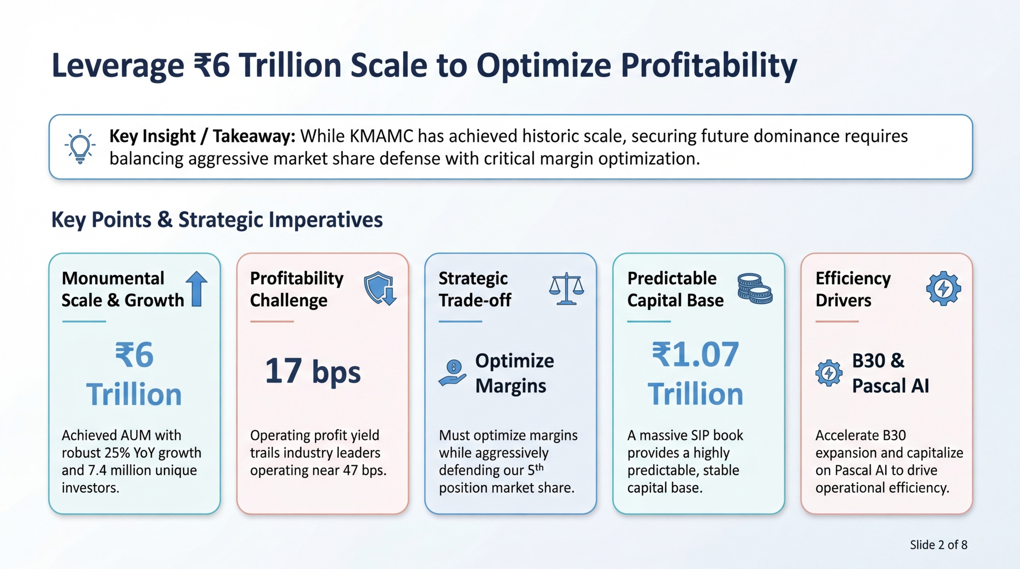

Slide 3
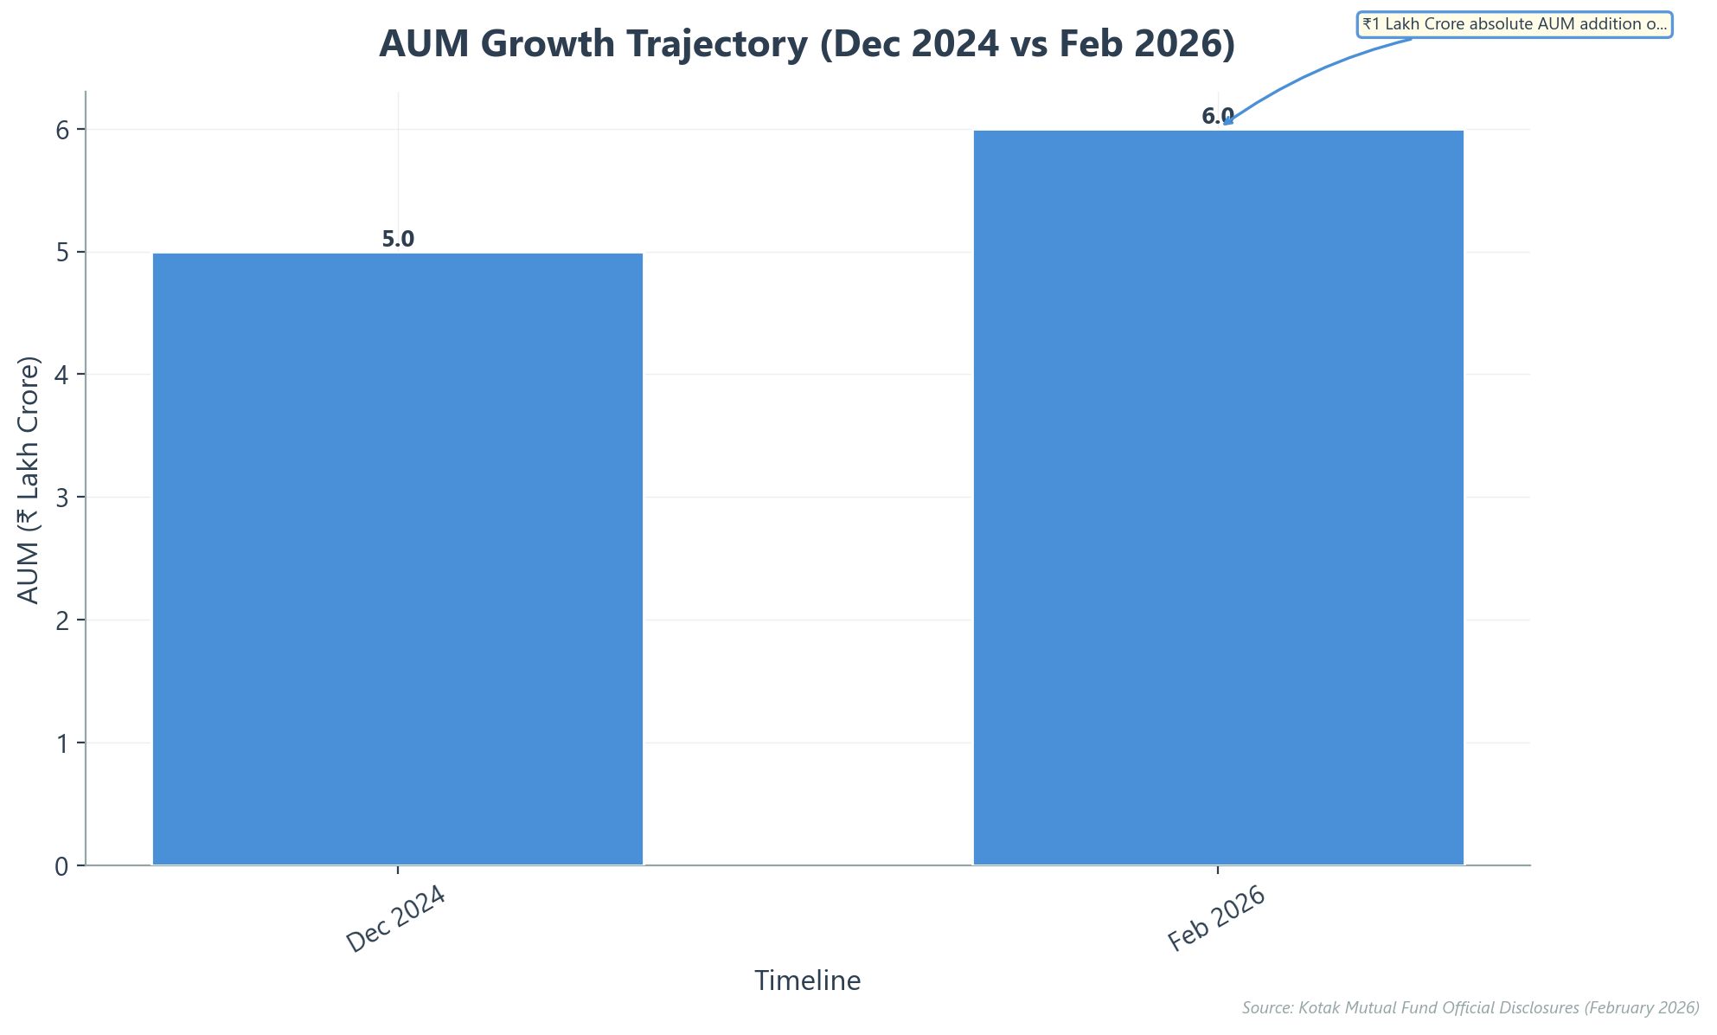
Securing Fifth Position by Surpassing ₹6 Trillion AUM
▸ Total managed capital hit record highs this February.
▸ Expanded portfolio twenty percent within fourteen months.
▸ Retained top-five industry rank with robust market share.
▸ Servicing 7.4 million unique individuals across numerous folios.
▸ Monthly systematic investment inflows currently exceed ₹1,500 crore.
★ KEY INSIGHT: Consistent 25% YoY growth has cemented KMAMC's position as the 5th largest AMC in India.
Kotak Mahindra AMC: Competitive Intelligence & Asset Analysis (FY 2025...
Slide 3 of 8

Slide 4
Sacrifice Short-Term Yields to Accelerate Retail Penetration
Asset Management Company | FY25 Profit After Tax | Operating Revenue Yield | Operating Profit Yield
ICICI Prudential AMC | ₹2,651 crore | 52 bps | 36 bps
SBI Mutual Fund | ₹2,540 crore | 33 bps | 25 bps
HDFC AMC | ₹2,461 crore | 47 bps | 36 bps
Nippon India AMC | ₹1,252 crore | 38 bps | 25 bps
Kotak Mahindra AMC | ₹977 crore | 27 bps | 17 bps
Source: FY25 AMC Profitability & Yield Reports
★ KEY INSIGHT: KMAMC strategically accepts the lowest operating yield among top peers to aggressively capture Tier-2 and Tier-3 market share before fintechs establish dominance.
Kotak Mahindra AMC: Competitive Intelligence & Asset Analysis (FY 2025...
Slide 4 of 8

Slide 5
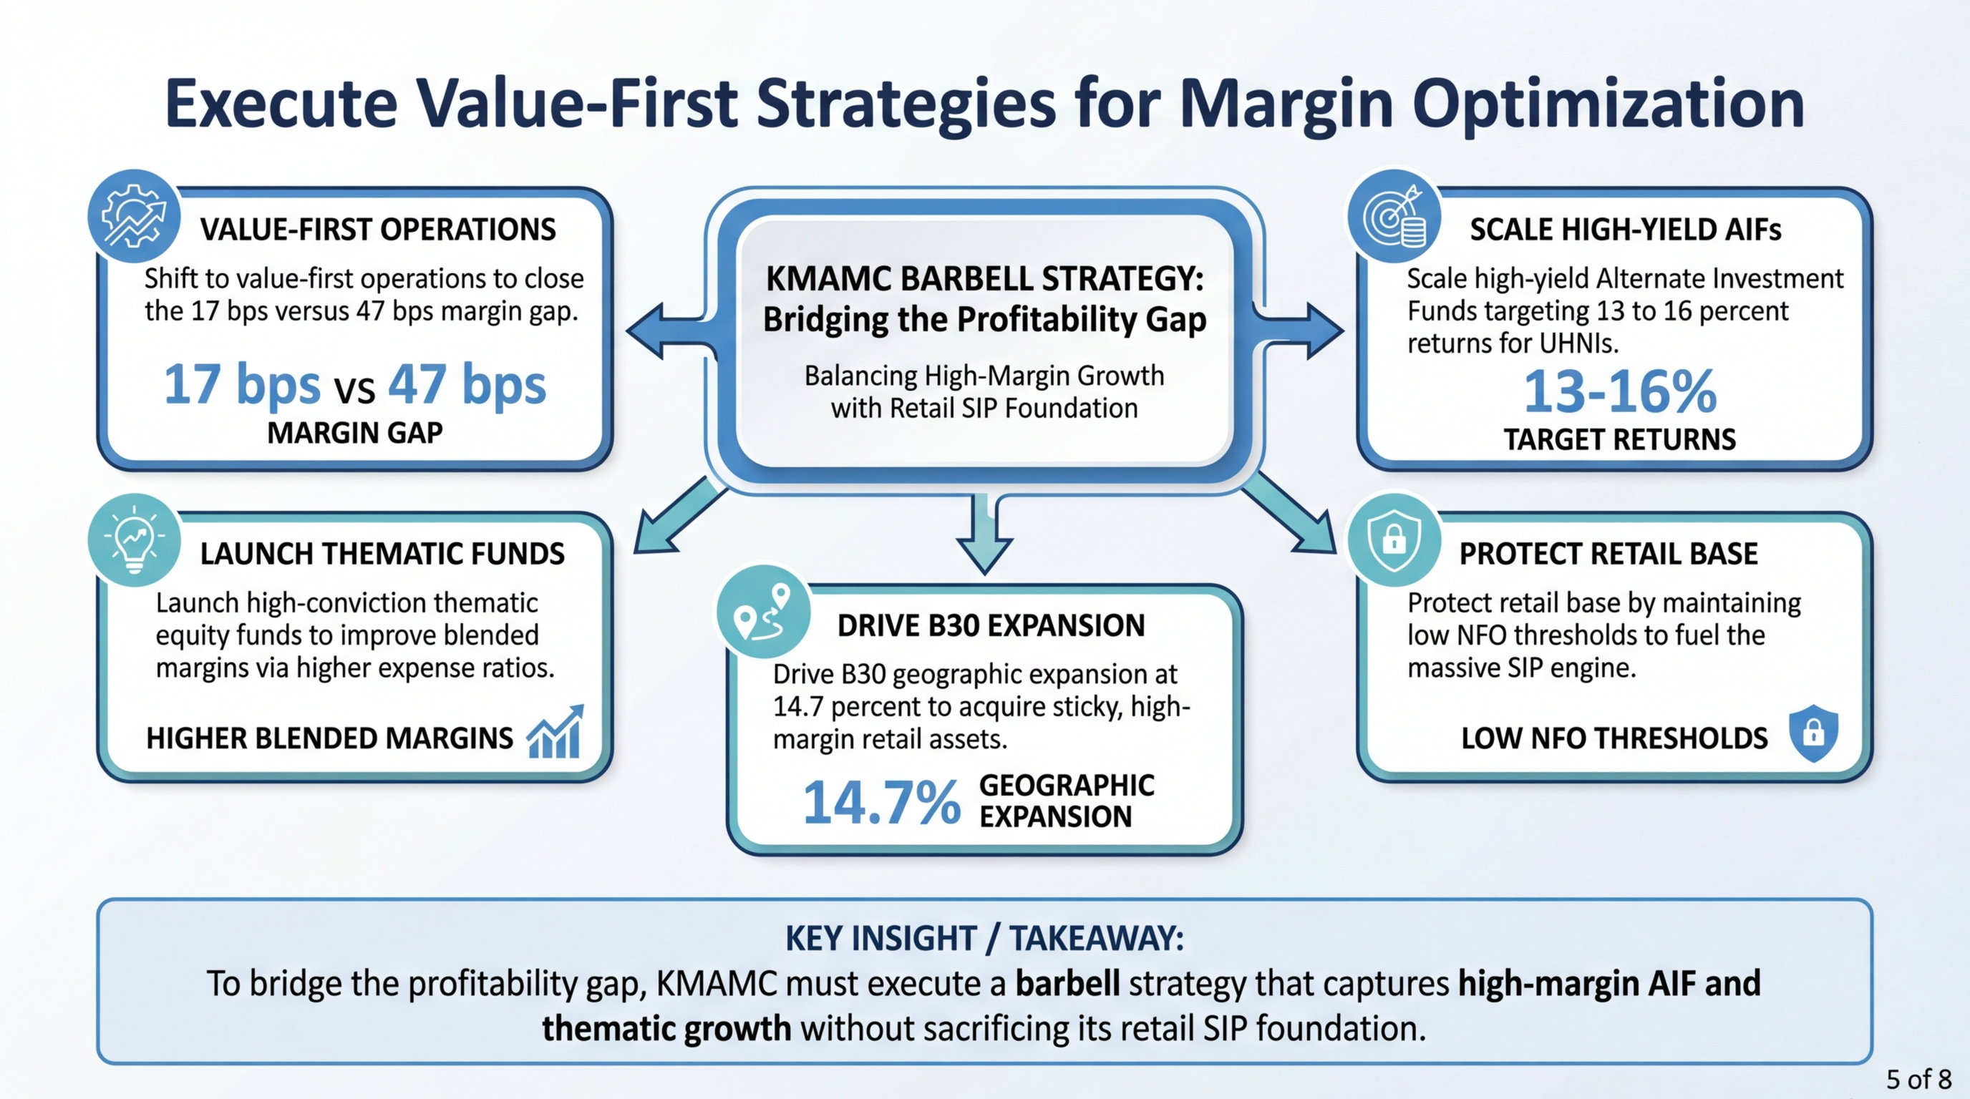

Slide 6
Accelerate Growth via B30 Markets and Retail SIPs
Strategic Pillar | Key Performance Indicator | Q3 FY26 Value | YoY Growth
Geographic Expansion | T30 Market AUM Growth | 87.7% Share | +7.6%
Geographic Expansion | B30 Market AUM Growth | 12.3% Share | +14.7%
Retail Resilience | Monthly SIP Inflows | ₹2,043 Crore | +10.0%
Retail Resilience | Total Domestic MF AUM | ₹5,86,610 Crore | +20.0%
Market Position | Equity AAUM Market Share | 6.39% | Maintained
Sources: AMFI Industry Data 2025-2026; Kotak Mahindra Bank Q3 FY26 Investor Presentation
★ KEY INSIGHT: B30 markets are growing at double the rate of T30, while SIPs provide a stable ₹2,043 Cr monthly capital cushion.
Kotak Mahindra AMC: Competitive Intelligence & Asset Analysis (FY 2025...
Slide 6 of 8

Slide 7
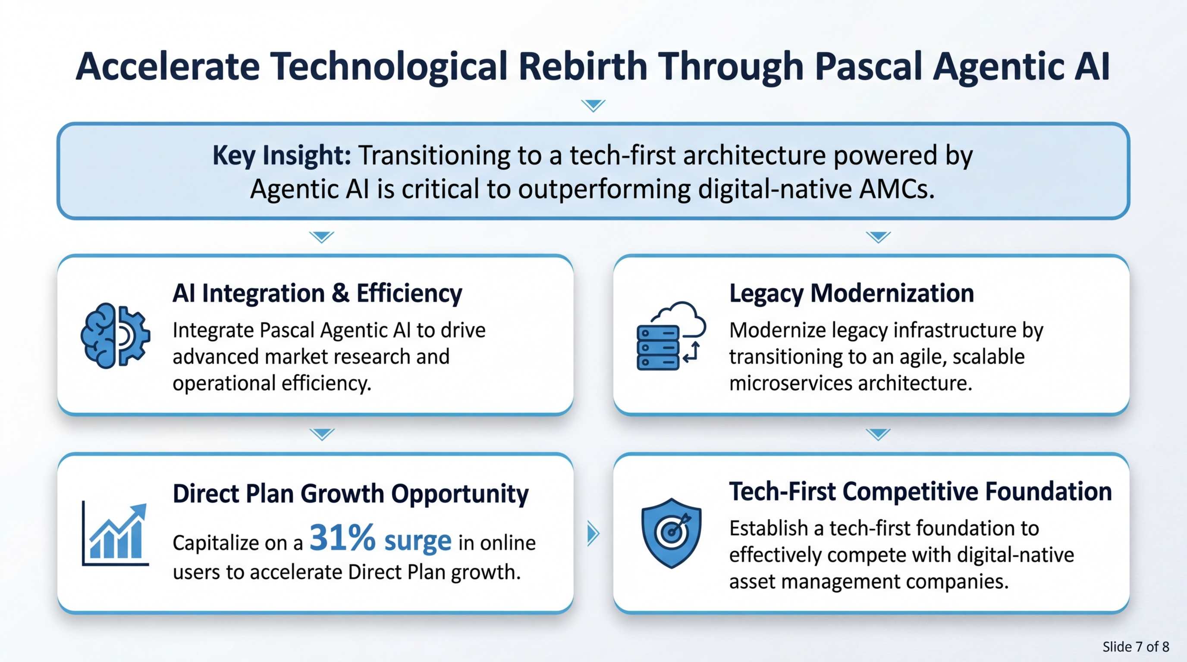

Slide 8
Drive FY27 Profitability Via Tech and Geographic Expansion
Execution of the B30 and Tech-First strategies will secure KMAMC's profitability and market position in FY27.

